Slide 1

Vodafone Churn Analysis
Understanding customer attrition patterns to drive data-driven retention strategies

Slide 2
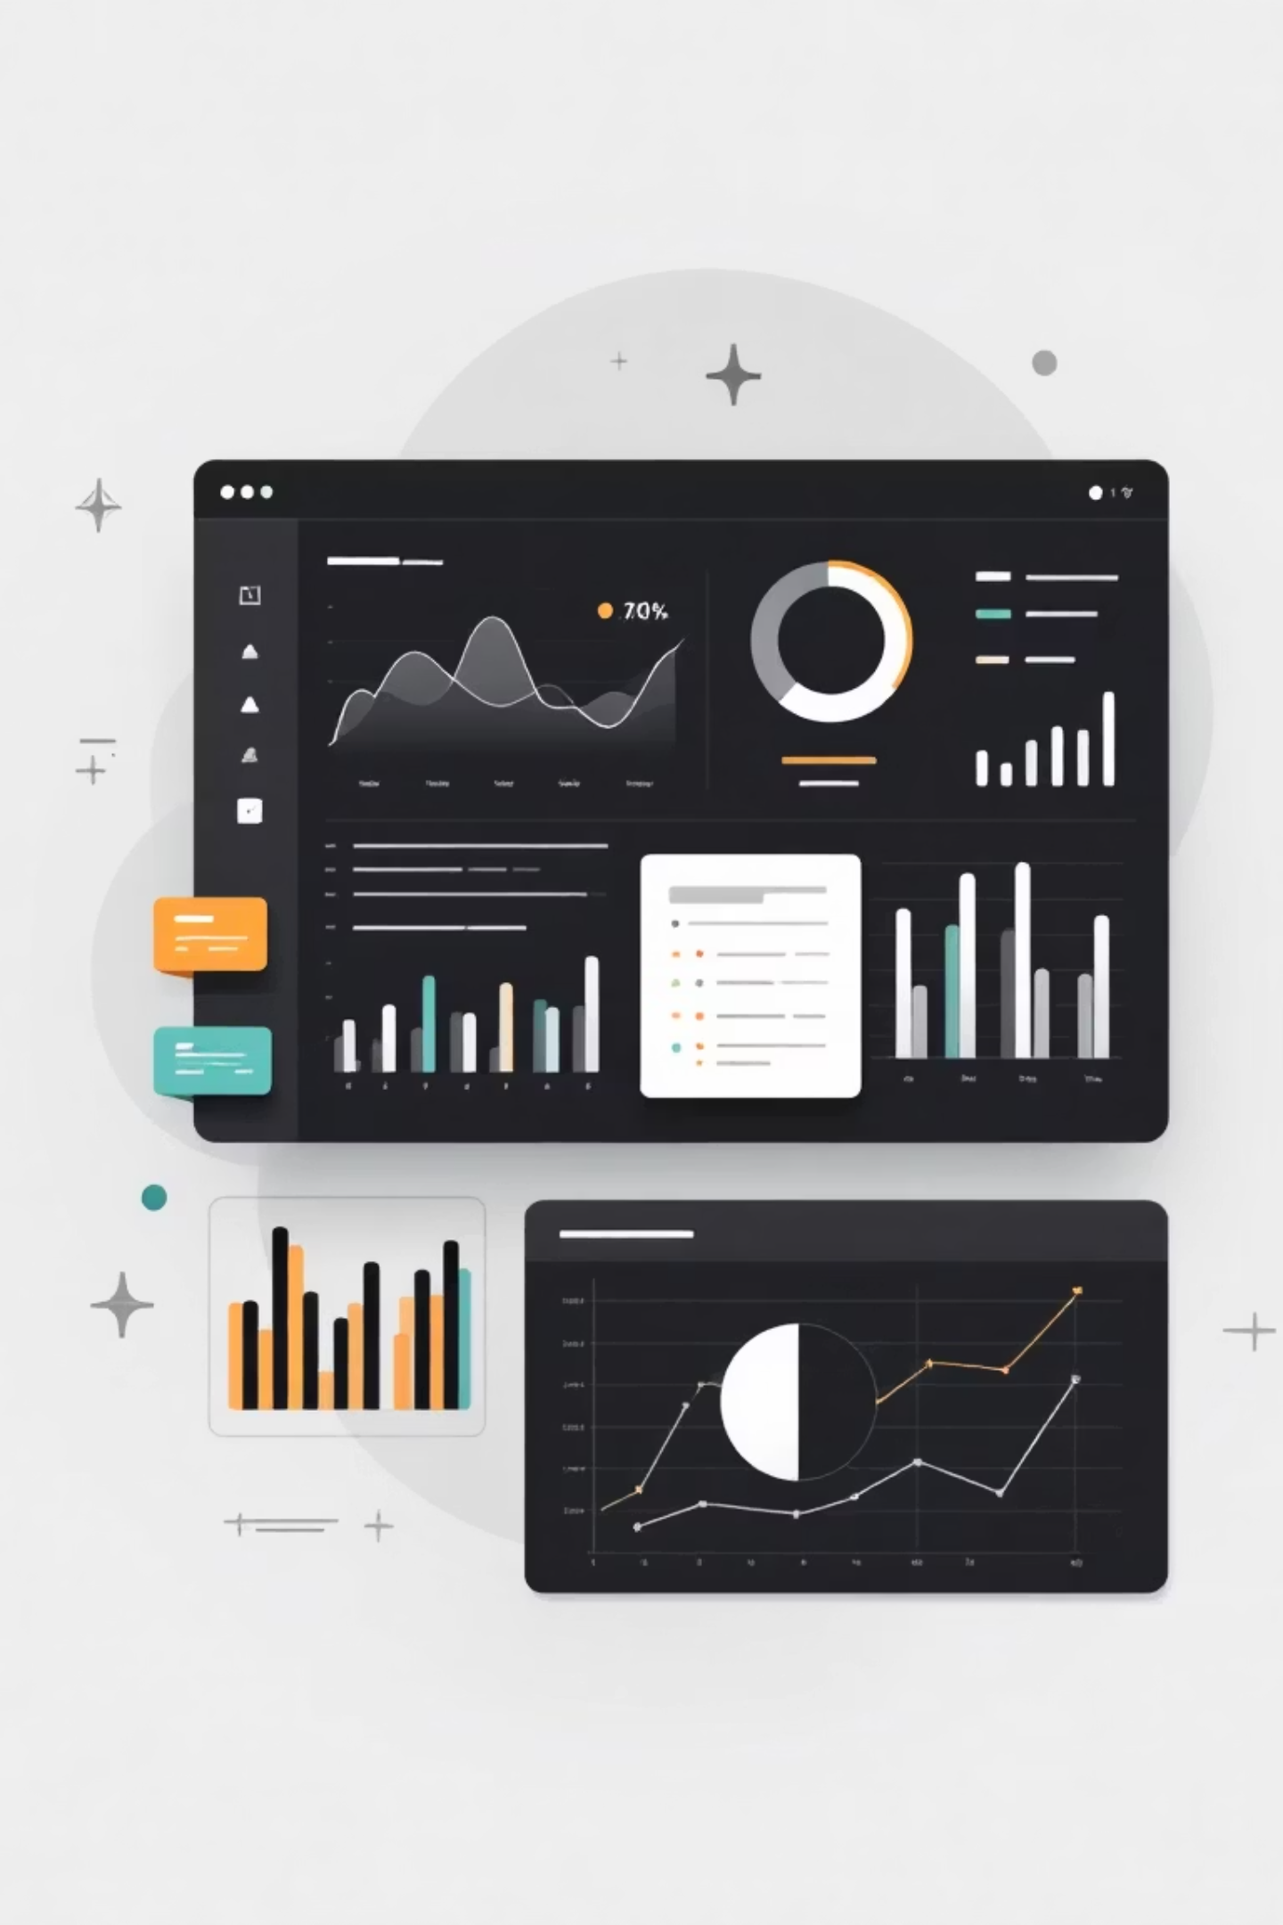
PROJECT OVERVIEW
Analyzing Customer Churn
Objective
Dataset
Identify churn patterns and high-risk customer segments to support retention strategies
6,441 customers across 23 features including demographics, services, billing, and support

Slide 3

DATA PREPARATION
Ensuring Data Quality
01
02
Initial Inspection
Standardization
Reviewed dataset structure and content across all 23 columns
Cleaned categorical text columns, removed leading/trailing spaces
03
04
Handling Blanks
Feature Engineering
Categorized unknown values, treated blanks as non-usage
Created churn_flag and tenure_group for enhanced analysis

Slide 4

KEY FINDING
Overall Churn Landscape
6,441
4,730
1,711
Total Customers
Retained
Churned
Complete dataset analyzed
Customers staying with Vodafone
Customers who discontinued service
27%
Churn Rate
Overall attrition percentage

Slide 5

DEMOGRAPHICS
Who's Leaving?
Senior Citizens
No Dependents
Higher churn rate compared to non-senior customers
Significantly higher churn than customers with dependents
Family Households
Stronger retention among family-oriented customers

Slide 6
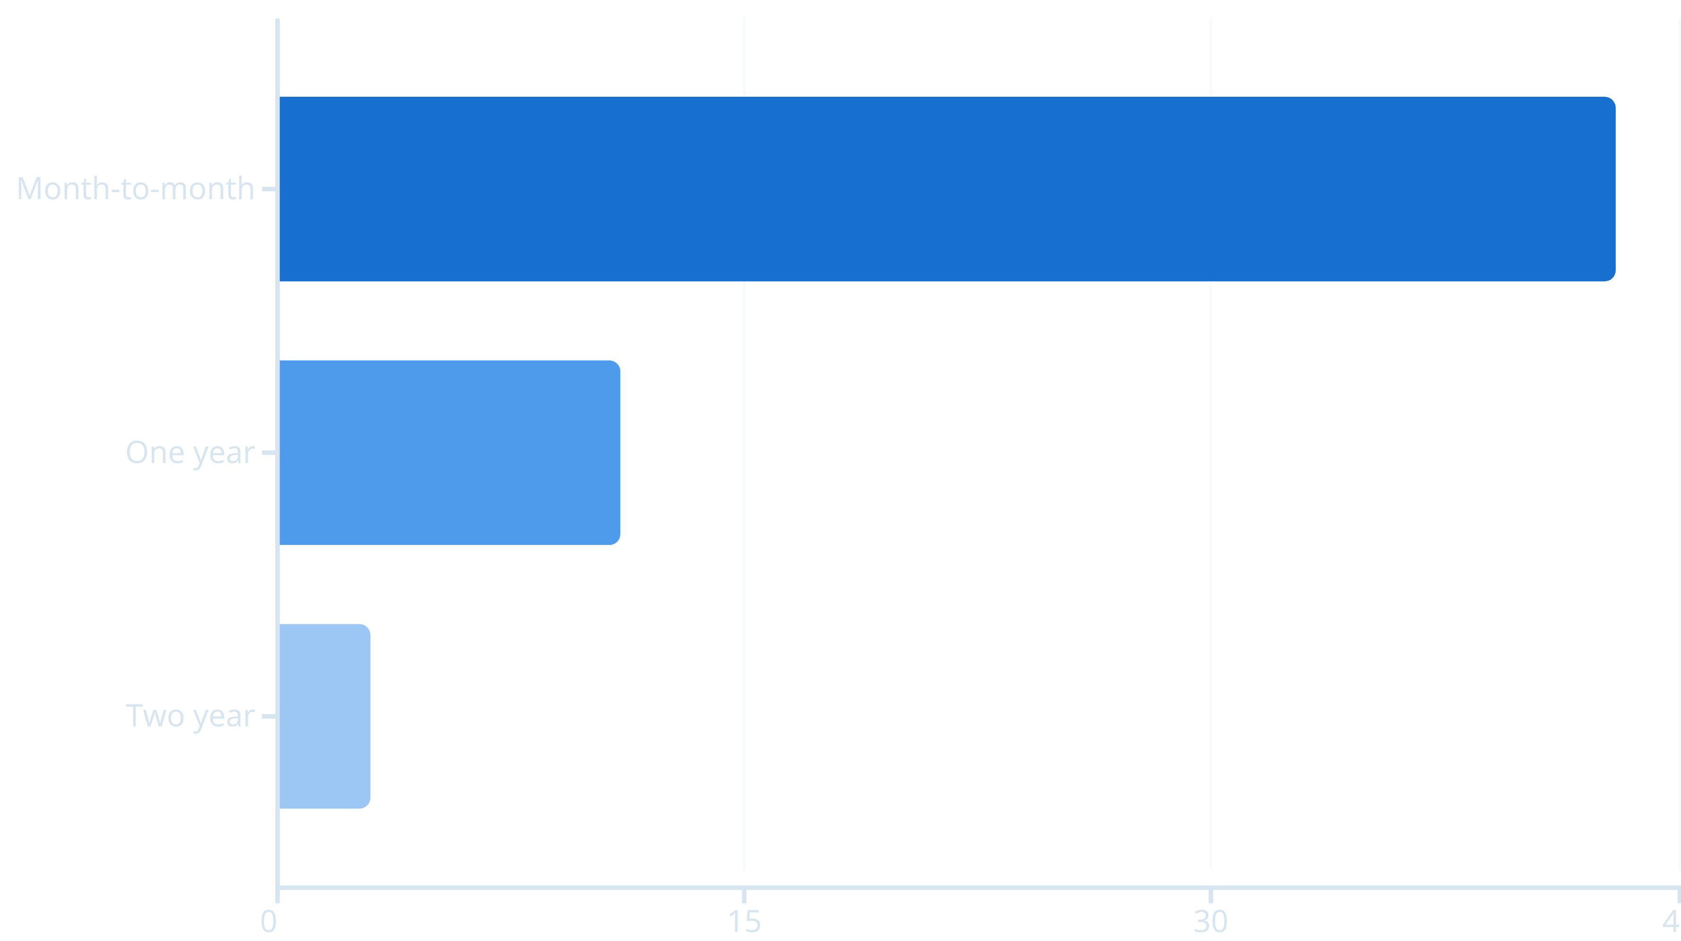

CONTRACT ANALYSIS
Contract Type Impact
Month-to-month contracts show significantly higher churn compared to two-year contracts.

Slide 7





CUSTOMER LIFECYCLE
Tenure Matters
49%
29%
0-1 Year
1-2 Years
Highest risk period
Moderate churn
20%
9%
2-4 Years
4+ Years
Declining risk
Loyal customers
Early-stage customers are 5x more likely to churn than long-term customers

Slide 8

BILLING INSIGHTS
Payment & Pricing Patterns
Monthly Charges
Payment Method Risk
Churned: $74.32
Electronic check users show significantly higher churn
Retained: $61.26
Automatic payment methods improve retention
Higher monthly charges correlate with increased churn risk

Slide 9
SUPPORT IMPACT
Technical Issues Drive Churn
88%
Support Correlation
Churned customers raise 7x more technical tickets
Churned Customers
Retained Customers
Average: 1.15 technical tickets
Average: 0.15 technical tickets
Strong link between service issues and customer attrition

Slide 10

ACTION PLAN
Strategic Recommendations
1
2
3
Onboarding Programs
Contract Incentives
Pricing Optimization
Target first-year customers with engagement initiatives to reduce early churn
Offer discounts and bundles to move customers to longer-term plans
Review high monthly charge plans to reduce price-sensitive churn
4
5
Payment Migration
Support Excellence
Promote automatic payment methods to electronic check users
Improve technical support quality and response times

Slide 11
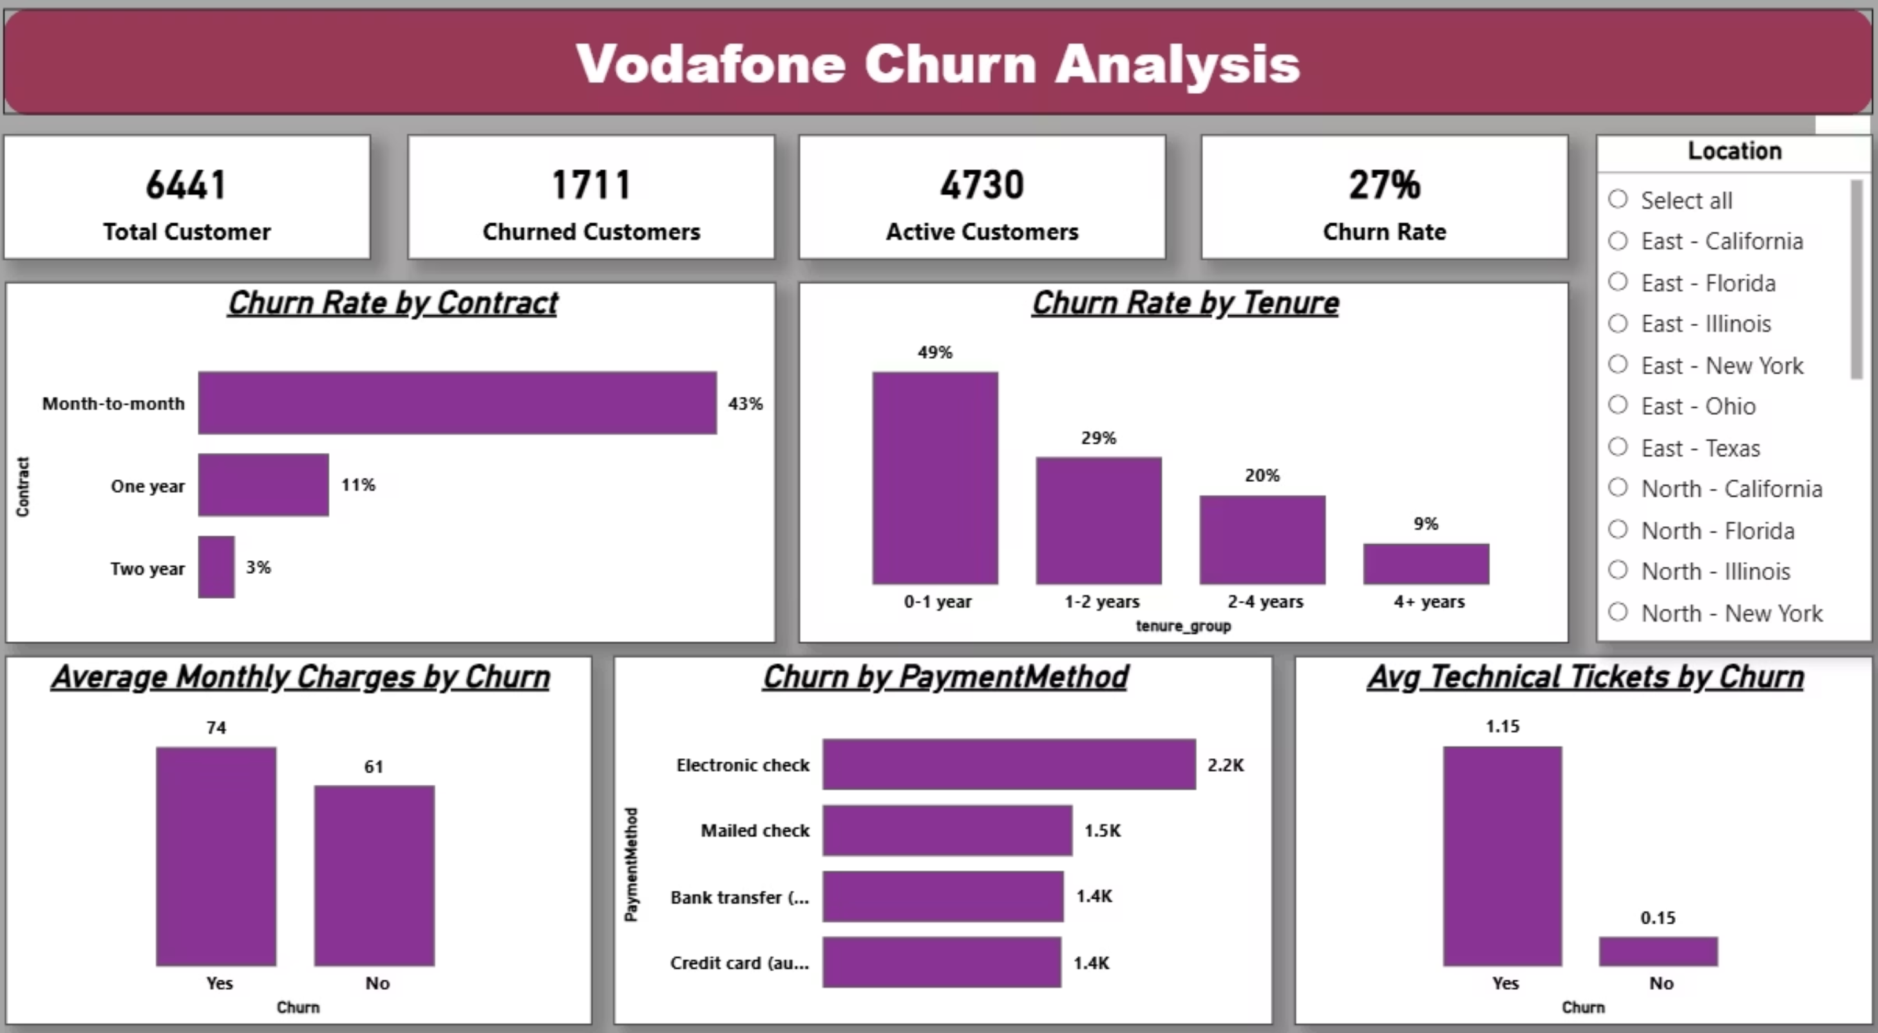
Dashboard

